Slide 1
Basic Electronics Engineering FE 2024 Course
Presented by
Mr. Aniruddha Nirmal
Assistant Professor
Department of First Year Engineering
DPCOE Pune

Slide 2
Unit 5 (ii): Communication Systems
Syllabus
Basic Communication System:
Block Diagram
Communication Media: Wired and Wireless
Electromagnetic Spectrum, Allotment of frequency band for different applications
Mobile Communication System:
Cellular concept
Simple block diagram of GSM system.

Slide 3
Prerequisites
Terminologies in Communication Systems
Introduction to modulation
Need of modulation
Types of Modulation
Brief introduction of AM and FM transmission

Slide 4
Communication Systems
Modulation
De-modulation
Information
Source
Transmitter
Communication Channel
Receiver
Destination
Noise
Sound, Picture,
Speech, Data
Information in
Original form
Fig. Block diagram of Basic Communication System

Slide 5
Communication Systems
1.Information source:
The objective of any communication system is to convey information from one point to the other.
The information comes from the information source, which originates it.
It generates the required message that is to be transmitted such as sound, picture, speech etc.
2.Transmitter:
The objective of the transmitter is to collect the incoming message signal so as to make it suitable for transmission and subsequent reception.
In transmitter the information modulates the carrier.
The modulation can be amplitude, frequency or phase depending upon the requirements.

Slide 6
Contd…
3.Channel:
Channel is the physical medium which connects the transmitter with that of the receiver.
It can be wired or wireless.
It includes copper wire, coaxial cable, fibre optic cable, radio waves, microwaves etc.
Noise enters in any communication system through channel.
Noise is an unwanted signal, random in nature.
It can not be removed but eliminated to some extent.

Slide 7
Contd…
4.Receiver
The receiver block receives the incoming modified message signal from the channel and processes it to recreate the original (non-electrical) form of the message signal.
There are a great variety of receivers in communication systems.
Its most important function is demodulation.
The output of receiver may be fed to a loudspeaker, television picture tube, computer etc.
5.Destination:
The destination is the final block in the communication system which receives the message signal and processes it to determine the information present in it.
Usually, humans will be the destination block.

Slide 8
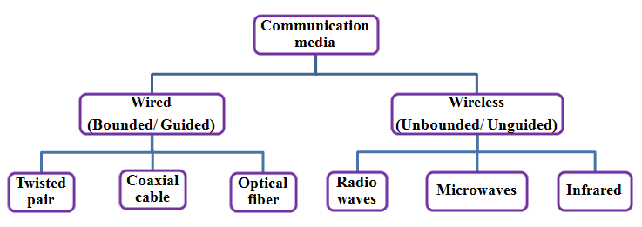
Communication Media
Different Communication Media

Slide 9

Communication Media
A. Wired Media (Bounded/Guided media) :
In this communication, devices are connected to each other by cables.
It is also known as bounded/guided media.
Example: Copper wire, Fiber optic cables etc.
Wired media are further categories as Twisted pair, Coaxial cable and Optical fiber.
1. Twisted Pair:
It consists of a pair of copper wires twisted around each other; the wires are around 1 to 2 mm thick and they are twisted to reduce the interference from the surrounding wires.
Remember that a current carrying wire has a magnetic field around it that can interfere with that of another wire when in close proximity. Twisted Pair is of two types:
i. Unshielded Twisted Pair (UTP):
This type of cable has the ability to block interference and does not depend on a physical shield for this purpose.
It is used for telephonic applications.
ii. Shielded Twisted Pair (STP):
This type of cable consists of a special jacket to block external interference.
It is used in fast-data-rate Ethernet and in voice and data channels of telephone lines.

Slide 10
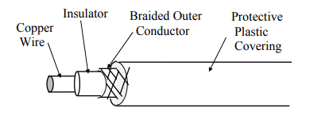
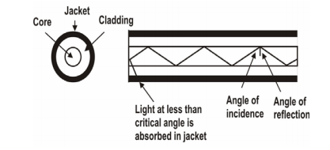
Contd…
2. Coaxial Cable:
Offering better data rates and less signal attenuation, a coaxial cable consist of a central copper conductor that is surrounded by a foil shield. The foil is covered by yet another shield known as a braided shield. Unlike twisted pairs, coaxial cables only have a single copper conductor. The conductor and the foil shield are separated by a dielectric.
Cable TVs and analog television networks widely use Coaxial cables.
3. Fiber Optic:
It is the most expensive of wired mediums and offers the highest
rates of data transmission. They are often used in long distance
communications and are never affected by any electromagnetic fields. This is because it
involves light.
A fiber optic cable is a thin, flexible, transparent medium made of very fine glass or plastic fibers. It utilizes the principle of total internal reflection.
It is used for transmission of large volumes of data.

Slide 11
Communication Media
B. Wireless media (Unbounded/Unguided media):
A wireless network uses radio waves as the sole medium for transmitting and receiving data. There are no wires involved. An example is the wireless router in your home. Radio waves are electromagnetic waves which are transverse in nature and they have the longest wavelength on the electromagnetic spectrum.
They travel at the speed of light and have frequencies ranging from 3 kHz to 3 GHz. Radio waves can easily be absorbed by most materials and can bend around objects as well. There are 3 major types of Unguided Media:
1. Radio waves: These are easy to generate and can penetrate through buildings. The sending and receiving antennas need not be aligned. Frequency Range:3KHz – 1GHz. AM and FM radios for transmission.
2. Microwaves: It is a line of sight transmission i.e. the sending and receiving antennas need to be properly aligned with each other. The distance covered by the signal is directly proportional to the height of the antenna. Frequency Range: 1GHz – 300GHz.
These are majorly used for mobile phone communication and television distribution.
3. Infrared: Infrared waves are used for very short distance communication. They cannot penetrate through obstacles. This prevents interference between systems. Frequency Range: 300GHz – 400THz. It is used in TV remotes, wireless mouse, keyboard, printer, etc.

Slide 12
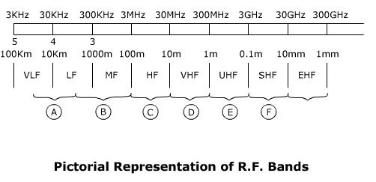
Electromagnetic Spectrum:
Electromagnetic Spectrum:
It is a signal made up of oscillating electric and magnetic fields.
The entire range of frequencies that the EM wave can produce oscillations is termed as Electromagnetic Spectrum.
For the classification purpose, the EM spectrum is divided into small segments and each segment is given a nomenclature.
Each range is identified by end frequencies or wavelengths that differ by a factor of 10.

Slide 13
Electromagnetic Spectrum: Allotment of frequency band for different applications
Frequency (f) range | Wavelength (λ) range | EM spectrum nomenclature
3 – 30 KHz | 100 – 10 Km | VLF – Very Low Frequency
30 – 300 KHz | 10 – 1 Km | LF – Low Frequency
0.3 – 3 MHz | 1000 – 100 m | MF – Medium Frequency
3 – 30 MHz | 100 – 10 m | HF – High Frequency
30 – 300 MHz | 10 – 1m | VHF – Very High Frequency
0.3 – 3 GHz | 1000 – 100 mm | UHF – Ultra High Frequency
3 – 30 GHz | 100 – 10 mm | SHF – Super High Frequency
30 – 300 GHz | 10 – 1 mm | EHF – Extremely High Frequency

Slide 14
Terminologies in Communication Systems:
Time ( t ): Time is a fundamental quantity with reference to which all communications happen. It is measured in seconds (sec).
Frequency ( f ): Frequency is fundamental quantity with reference to which all signals in a communication system are more commonly distinguished. Frequency is defined as the number of oscillations per second and is measured in hertz (Hz).
Wavelength (λ) : Wavelength is defined as the distance travelled by an EM wave during the time of one cycle.
Spectrum: The frequency domain representation of the given signal.
Bandwidth (B.W.) : It is that portion of the EM spectrum occupied by a signal. More specifically it is the range of frequencies over which the information is present in the original signal and hence it may also be termed as signal bandwidth.
Channel Bandwidth: The range of frequencies required for the transmission of modulated signal.
Modulation: Modulation is a process in which any of the characteristics of carrier signal such as amplitude, frequency or phase is varied according to the instantaneous value of modulating signal.
Baseband Signal: Message signal in its original frequency range.

Slide 15
Mobile communication system: Cellular concept
Why use of cellular network?
The immense potential of conventional telephone cannot be exploited to its maximum due to the limitation imposed by the connecting wires. But this restriction has been removed with the advent of the cellular radio.
If we use dedicated RF loop for every subscriber, we need larger bandwidth to serve even a limited number of subscriber in a single city.
To overcome this B.W. problem, subscribers have to share the RF channels on need basis, instead of dedicated RF loops. This can be achieved by using multiple access methods FDMA, TDMA, or CDMA. Even then the number of RF channels required to serve the subscribers, works out to be impracticable.
With limited frequency resource, cellular principle can serve thousands of subscribers at an affordable cost. In a cellular network, total area is subdivided into smaller areas called “cells”. Each cell can cover a limited number of mobile subscribers within its boundaries. Each cell can have a base station with a number of RF channels.
Frequencies used in a given cell area will be simultaneously reused at a different cell which is geographically separated.

Slide 16
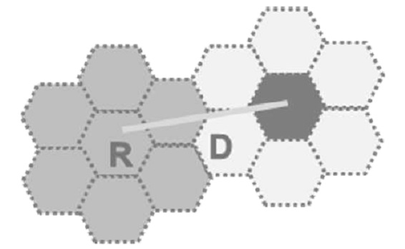
Contd…
Frequencies used in a given cell area will be
simultaneously reused at a different cell which is geographically separated.
For example,
a typical seven-cell pattern can be considered.
Total available frequency resources are divided
into seven parts, each part consisting of a number of radio channels and allocated to a cell site
In a group of 7 cells, available frequency spectrum is consumed totally. The same seven sets of frequency can be used after certain distance.
The group of cells where the available frequency spectrum is totally consumed is called a cluster of cells.
Two cells having the same number in the adjacent cluster, use the same set of RF channels and hence are termed as “Co-channel cells”. The distance between the cells using the same frequency should be sufficient to keep the co-channel (co-ch) interference to an acceptable level. Hence, the cellular systems are limited by Co-channel interference.

Slide 17
Contd…
Shape of Cells
For analytical purposes a “Hexagon” cell is preferred to other shapes on due to the following reasons.
A hexagon layout requires fewer cells to cover a given area. Hence, it envisages fewer base stations and minimum capital investment.
Other geometrical shapes cannot effectively do this. For example, if circular shaped cells are there, then there will be overlapping of cells.
Also for a given area, among square, triangle and hexagon, radius of a hexagon will be the maximum which is needed for weaker mobiles.

Slide 18
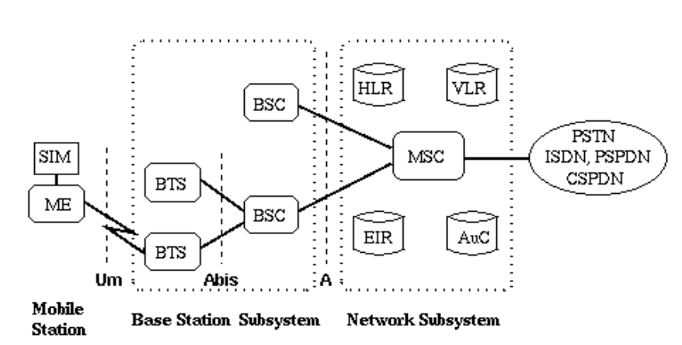
GSM: Global System for Mobile Communication
Block Diagram of GSM:
Global System for Mobile (GSM) is a second generation cellular standard developed to cater voice services and data delivery using digital modulation .

Slide 19
Contd…
The GSM network architecture consists of three major subsystems:
i) Mobile Station (MS)
ii) Base Station Subsystem (BSS)
iii) Network and Switching Subsystem (NSS)
The wireless link interface between the MS and the Base Transceiver Station (BTS), which is a part of BSS. Many BTSs are controlled by a Base Station Controller (BSC). BSC is connected to the Mobile Switching Center (MSC), which is a part of NSS. Figure shows the key functional elements in the GSM network architecture.
1. Mobile Station (MS):
A mobile station communicates across the air interface with a base station transceiver in the same cell in which the mobile subscriber unit is located. The MS communicates the information with the user and modifies it to the transmission protocols if the air-interface to communicate with the BSS. The user’s voice information is interfaced with the MS through a microphone and speaker for the speech, keypad, and display for short messaging, and the cable connection for other data terminals. The MS has two elements. The Mobile Equipment (ME) refers to the physical device, which comprises of transceiver, digital signal processors, and the antenna. The second element of the MS is the GSM is the Subscriber Identity Module (SIM).

Slide 20
Contd…
2. Base Station Subsystem (BSS):
A base station subsystem consists of a base station controller and one or more base transceiver station. Each Base Transceiver Station defines a single cell. A cell can have a radius of between 100m to 35km, depending on the environment. A Base Station Controller may be connected with a BTS. It may control multiple BTS units and hence multiple cells. There are two main architectural elements in the BSS – the Base Transceiver Subsystem (BTS) and the Base Station Controller (BSC). The interface that connects a BTS to a BSC is called the A-bis interface. The interface between the BSC and the MSC is called the A interface, which is standardized within GSM.
3. Network and switching subsystem (NSS):
The NSS is responsible for the network operation. It provides the link between the cellular network and the Public switched telecommunicates Networks.

Slide 21
List of Text Books & Reference books
Text Books
1) “Electronics Devices” by Thomas. L. Floyd,9th Edition, Pearson (Unit I, II)
2) “Modern Digital Electronics” by R.P. Jain, 4th Edition, Tata McGraw Hill (Unit III)
3) “Electronic Instrumentation” by H.S. Kalsi, 3rd Edition, Tata McGraw Hill (Unit IV)
4) “Sensors and Transducers” by D. Patrnabis, 2nd Edition, PHI (Unit V)
5) “Electronic Communication Systems” by Kennedy & Davis, 4th Edition, Tata McGraw Hill (Unit V)
6) “Mobile Wireless communication” by M. Schwartz, Cambridge University Press (Unit V)
Reference Books
1) “Digital Fundamentals” by Thomas. L. Floyd, 11th Edition, Pearson
2) “Mobile Communication” by J. Schiller, 2nd Edition, Pearson
3) “Sensors Handbook”, by S. Soloman, 2nd Edition.
4) "Electronics Communication System" By William Schweber
5) "Electronics Communication System" By George Kennedy 5th Edition, McGraw Hill

Slide 22
THANK YOU

